Slide 1




Federico ALEGRE 3rd Year PhD Candidate
Spoofing countermeasures for speaker verification systems
Speech and Audio Processing Research Group
Supervisor: Nick EVANS

Slide 2
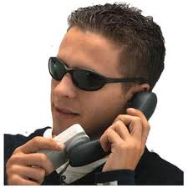

Spoofing: threat for biometric systems
Spoofing: presentation of a falsified trait to the sensor of a biometric system to provoke illegitimate acceptance.
EU FP7 Tabula Rasa Project:
2D Face,
3D Face,
Fingerprint,
Voice,
Gait, …
Spoofing for Voice:
Systems: 6 different including one state-of-the-art
Attacks: replay, synthesis, voice conversion, artificial signals
False acceptance increases from 5% to 50-90%

Slide 3
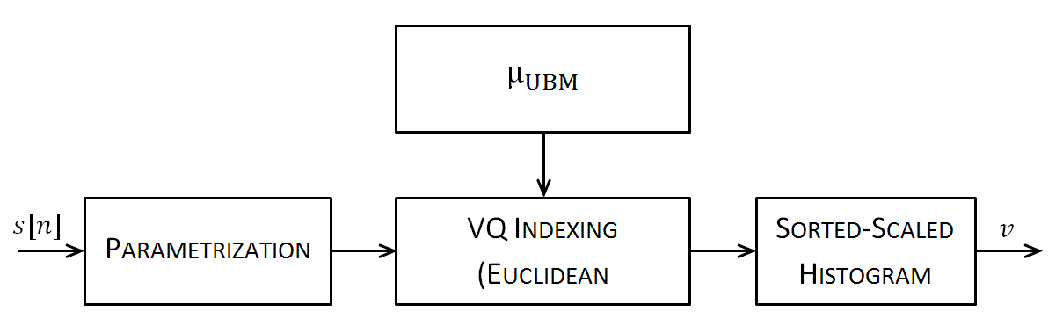
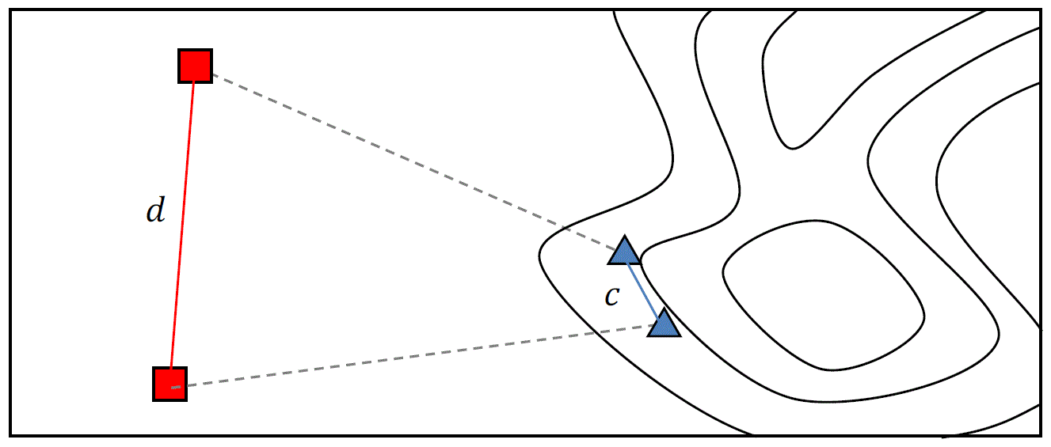
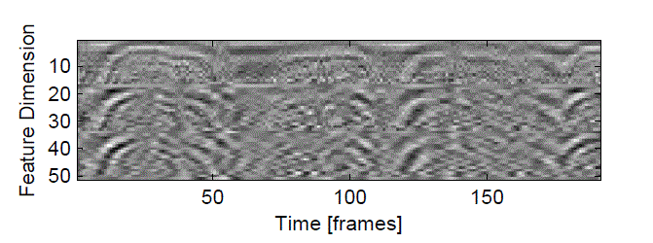
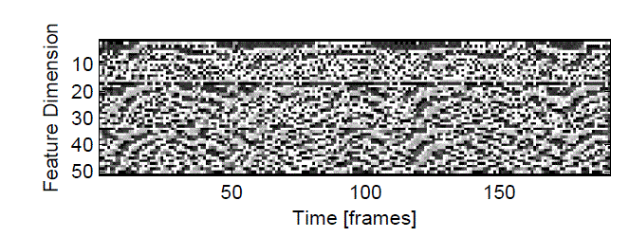
Spoofing Countermeasures
higher-level features
speech quality assessment
pair-wise distances against voice conversion
False acceptance decreases from 90% to < 3%
Local Binary Patterns (LBP)
one-dimensional
two-dimensional
fusion

Slide 4

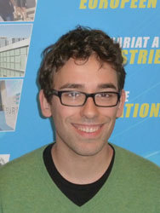


Giovanni SOLDI 1st Year PhD Candidate
Linguistic normalization for speaker diarization and recognition
Speech and Audio Processing Research Group
Supervisor: Nick EVANS
Notes:
Hello everybody. My name is Giovanni Soldi and I’m studying linguistic normalization for speaker diarization and recognition within the Speech and Audio Processing Research Group. My work is fully sponsored by Intel in Sophia Antipolis and Intel in Portland, Oregon.

Slide 5
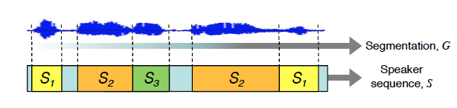
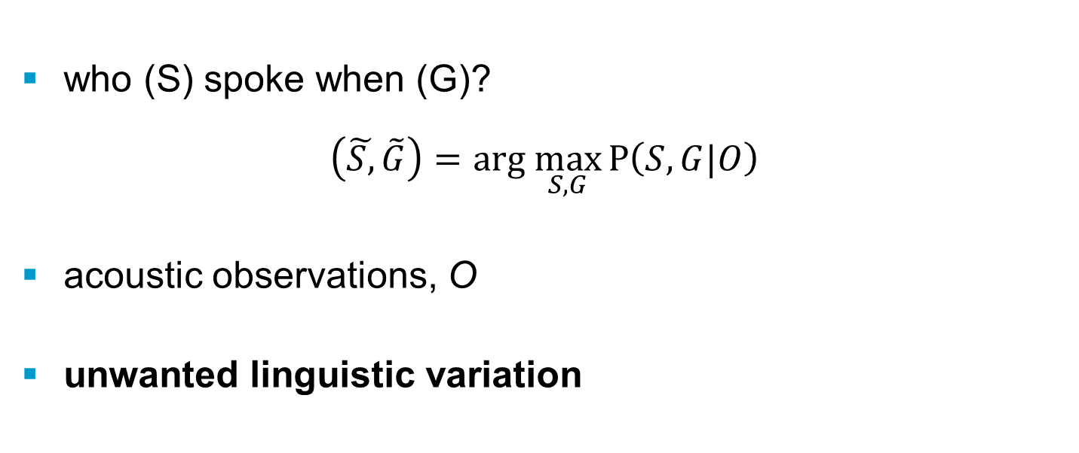
What is Speaker Diarization?
who (S) spoke when (G)?
$$\left(\tilde{S,}\tilde{G}\right)=\text{arg} \max_{S,G}{P\left(S,G|O\right)}$$
acoustic observations, O
unwanted linguistic variation
Notes:
Given an acoustic stream represented by a set of acoustic features O speaker diarization answers the question: who spoke when? Variation in the linguistic content of the acoustic stream typically degrades diariation performance. Therefore, new normalisation strategies are needed to supress such variation.

Slide 6
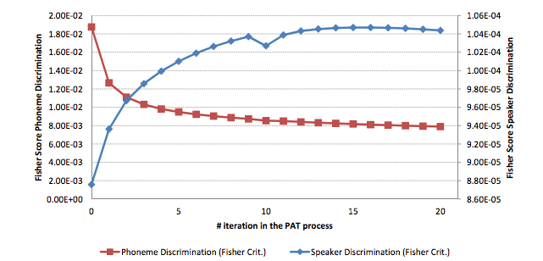
PAT: Phone adaptive training
PAT maximizes the inter-speaker variation while minimizing the intra-speaker variation
Notes:
Our new approach, referred to as phone adaptive training, maximizes inter-speaker variation in the feature space of an audio sequence as shown by the blue profile illustrated. As shown by the red profile, intra-speaker variation is simultaneously minimised and thus speaker diarization performance is improved. I will be happy to describe this work to you during the poster session!

Slide 7
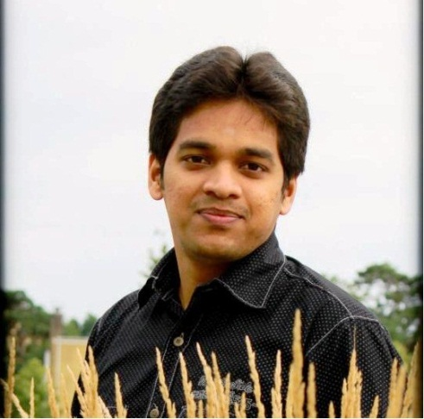

Leela Krishna GUDUPUDI 1st Year PhD Candidate
Nonlinear Acoustic Echo Cancellation
Speech and Audio Processing Research Group
Supervisor: Nick EVANS
Notes:
Hello everybody, I’m Leela Krishna Gudupudi and I am working on Nonlinear acoustic echo cancellation within the Speech and Audio processing research group. My work is sponsored by INTEL here in Sophia Anitpolis.

Slide 8

The echo reduction approach
Near end
Far end
AEC
GSM
AEC
Notes:
Acoustic echo is caused by coupling between the loudspeaker and the microphone of a mobile terminal. Acoustic echo cancellation is generally used to suppress echo but commonly assume linear conditions. The demand for smaller terminals and transducers, however, lead to nonlinear distortion and degraded AEC performance. EURECOM is working with Intel to develop new approaches to non-linear AEC.
8

Slide 9
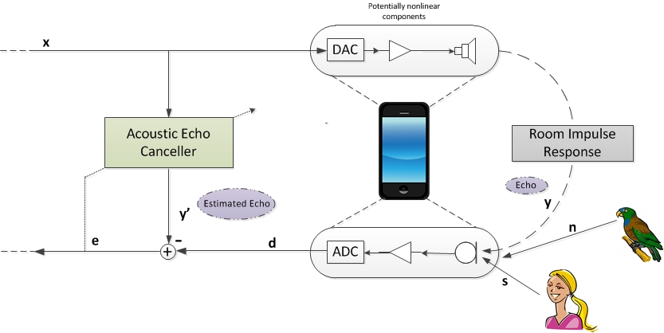
Non-linearities
Notes:
Sources of non-linearity typically include uplink/downlink amplifiers, the loudspeaker, the analogue-to-digital and digital-to-analogue converters, in addition to resonance from the terminal housing. I am currently studying a number of nonlinear AEC algorithms developed through a previous EURECOM-Intel collaboration. My work is concentrating on improving the attenuation of non-linearities while managing computational complexity for real time implementations. I will be happy to describe my work to you later during the poster session.

Slide 10
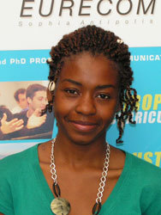

Christelle YEMDJI 3rd Year PhD Candidate
Acoustic echo processing for dual-microphone mobile terminals
Speech and Audio Processing Research Group
Supervisor: Nick EVANS
Notes:
Hello. My name is Christelle YEMDJI. I’m working on acoustic echo control for dual-microphone mobile phones and my work is supported by Intel Mobile Communications here in Sophia Antipolis.

Slide 11
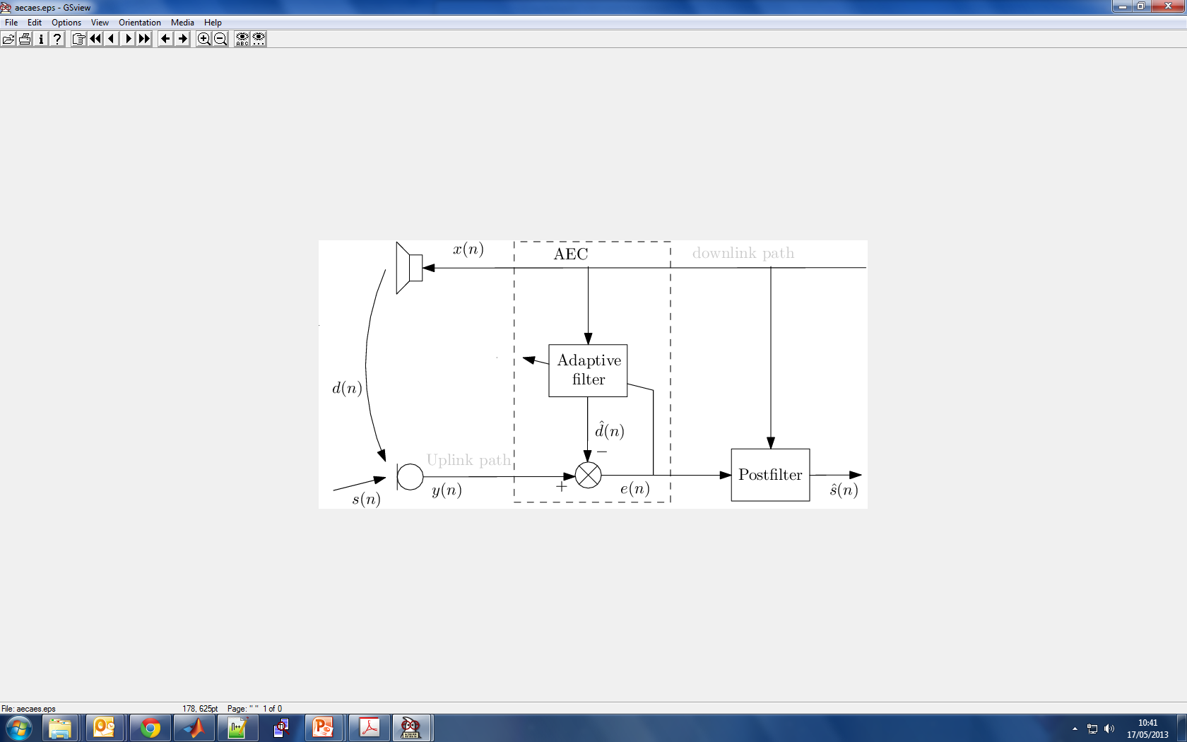
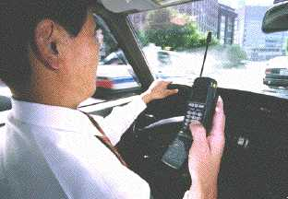

Acoustic echo and its control
Acoustic echo: coupling between loudspeaker and microphone
Far-end speaker might hear his own voice
Annoyance due to echo increases with the level and the delay
Existing echo control scheme are composed of adaptive filtering followed by echo postfiltering
Near-end Acoustic Environment
Far-end Acoustic Environment
Near-end terminal
Echo
Speech
Noise
Notes:
Acoustic echo is due to the coupling between the loudspeaker and the microphone of a mobile phone and can cause us to hear a delayed version of our own voices during a conversation.
Mobile phones are equipped with echo control systems which are often composed of adaptive filtering followed by postfiltering.
Technology developed by EURECOM is already in use in some of today’s mobile telephones – you might have EURECOM inside!

Slide 12
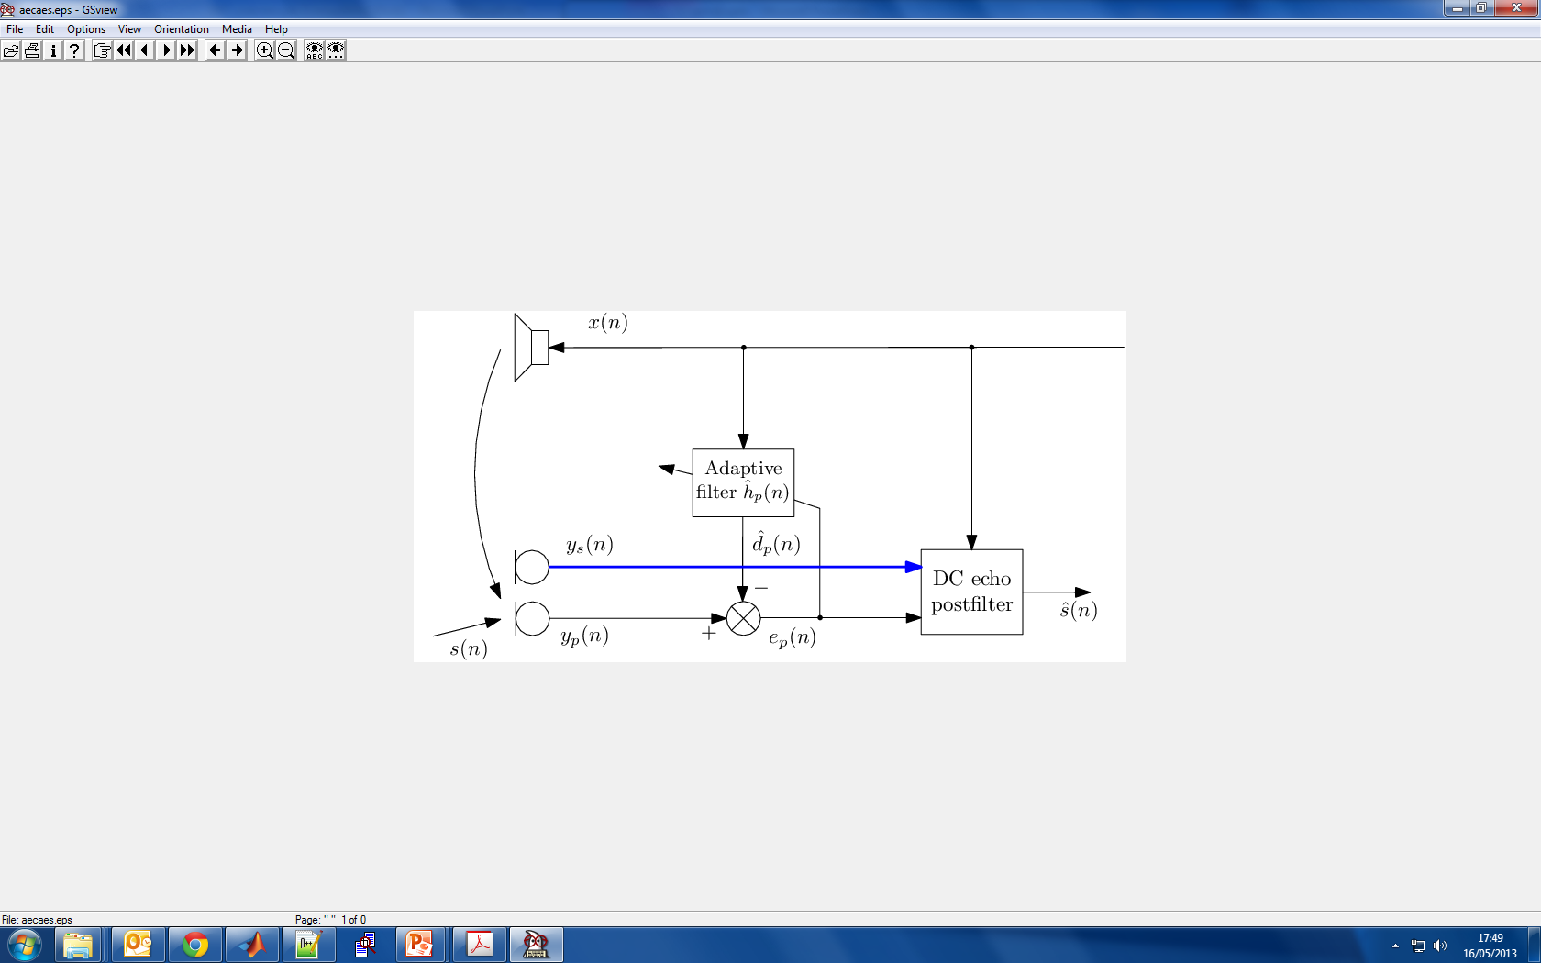
Dual microphone echo control
Some mobile devices are equipped with two microphone i.e. iPhone 4, Google Nexus One
Novel approach to echo processing for dual-microphone devices
Echo control scheme composed of adaptive filtering followed by echo postfiltering
echo control approach outperforms single-microphone approach
Notes:
In my poster I will present a novel approach to echo control designed for dual-microphone mobile phones.
My work shows that dual-microphone echo control leads to improved echo suppression.
I will be happy to describe my work to you later.

Slide 13
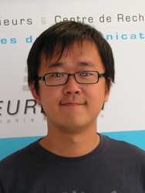
Xuran ZHAO 3rd Year PhD Candidate
Multi-view Dimensionality Reduction for Multi-modal biometrics
Speech and Audio Processing Research Group
Multimedia Image Processing Group
Supervisors: Nick EVANS and Jean-Luc DUGELAY
Notes:
Hello. My name is Xuran Zhao and I’m studying in the Speech and audio processing and Image processing research groups. My research is focused on Multi-view Dimensionality Reduction for Multi-modal biometrics, namely speaker recognition and face recognition.

Slide 14
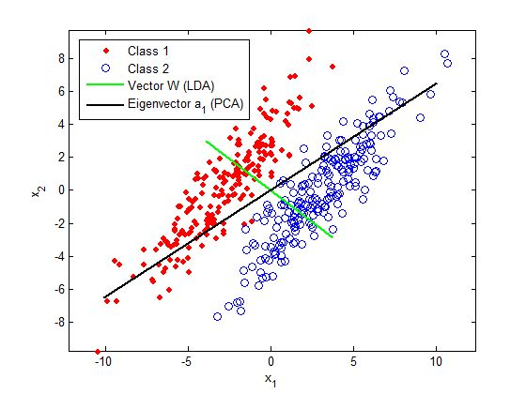



Dimensionality Reduction in Biometrics
Dimensionality reduction (DR) is often performed on biometric data in order to extract discriminative features;
Single-view DR methods:
Supervised (LDA, etc.)
high discriminative power
need large labeled training set
Unsupervised (PCA, etc.)
low discriminative power
need only unlabeled data
Approaches to multi-view DR model correlation which is not necessarily reflective of underlying clustering
Notes:
The use of dimensionality reduction is popular in almost all biometrics research and helps to improve classification performance through the identification of discriminative features. Single-view approaches to dimensionality reduction are well-known but ill-suited to multi-view problems. Approaches to multi-view dimensionality reduction model the correlation which does not always reflect the true clustering. My work has instead focused on modelling the inherent data structure.

Slide 15
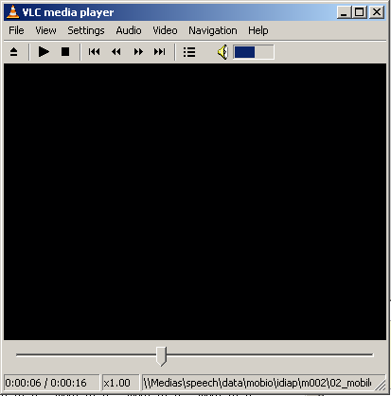
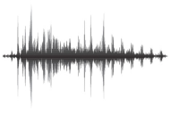
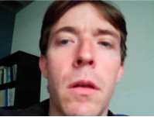

MVDR for Multi-modal Biometrics
Bio-model, paired features (Voice and Face for example)
Multi-view Dimensionality Reduction (MVDR)
sub-space data structure agreement
need small amount or no labeled data
high discriminative power
EURECOM algorithms outperform the state-of-the-art
Biometric recognition, clustering and retrieval purposes
Notes:
The BioCoMode project focuses on dimensionality reduction techniques for bi-modal voice-face recognition. EURECOM has pioneered a new sub-space data structure agreement concept which allows more discrimative biometric classifiers to be trained with less data. Our new MVDR approaches outperform the current state-of-the-art and are flexilble in their application to a wide range of classification problems. I will happily explain our work to you later.

